Slide 1


Slide 2
Introduction
How to move data analytics from cloud servers to edge devices to ensure timeliness and privacy for recommendation system?
How to effectively learns local and global user preference signals for accurate sequential recommendation?

Slide 3
Introduction
A dynamic context-aware compositional embedding scheme was devised for where the item embedding was generated by the combination of base embeddings.
A novel twin-attention sequential framework was proposed, which specializes the learning of long- and short-term user preference signals via a dedicated self-attention and convolution operation, respectively.

Slide 4
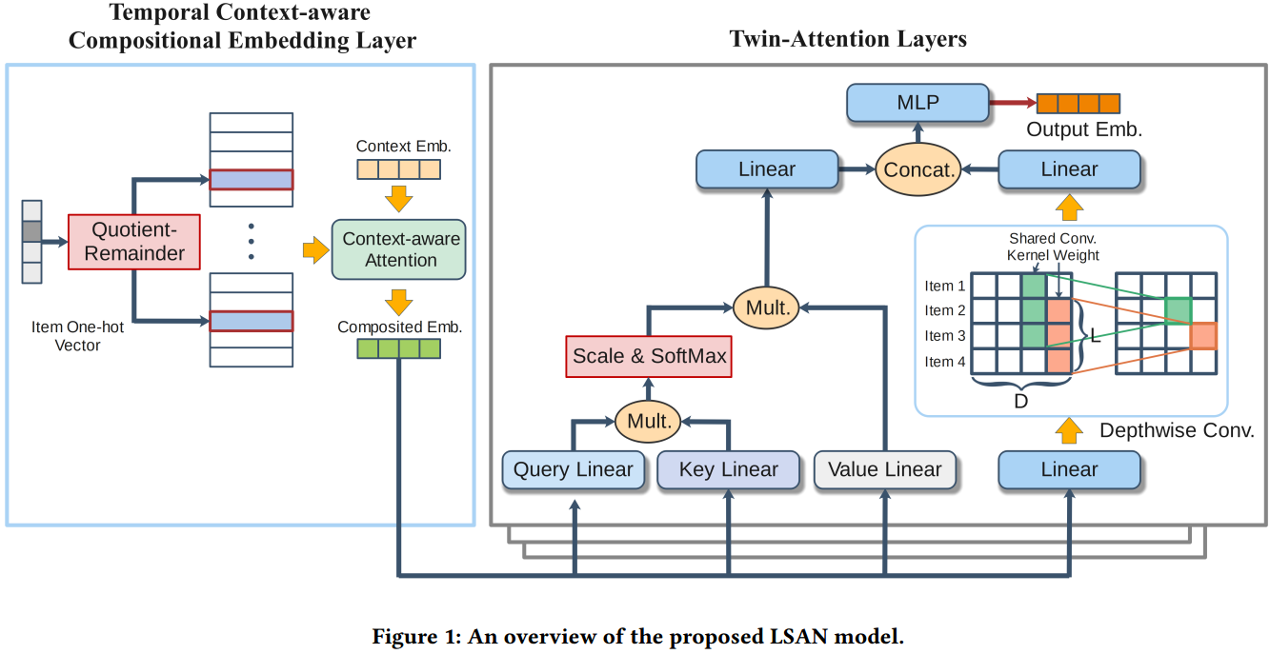
An Overview of LSAN (Lightweight Self-attentive network)

Slide 5
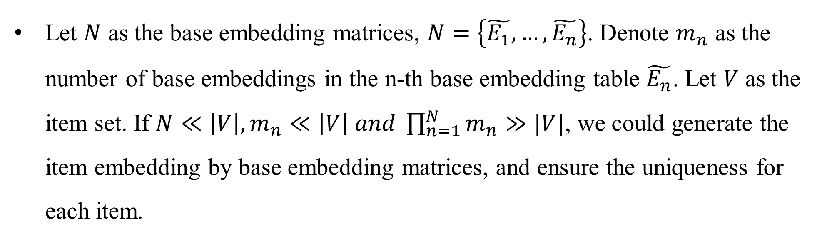
Dynamic Context-aware Compositional Embedding
Let $N$ as the base embedding matrices, $N=\left\{\tilde{E_{1}},…,\tilde{E_{n}}\right\}$. Denote $m_{n}$ as the number of base embeddings in the n-th base embedding table $\tilde{E_{n}}$. Let $V$ as the item set. If $N≪\left|V\right|,m_{n}≪\left|V\right| and \prod_{n=1}^{N}{m_{n}≫|V|}$, we could generate the item embedding by base embedding matrices, and ensure the uniqueness for each item.

Slide 6
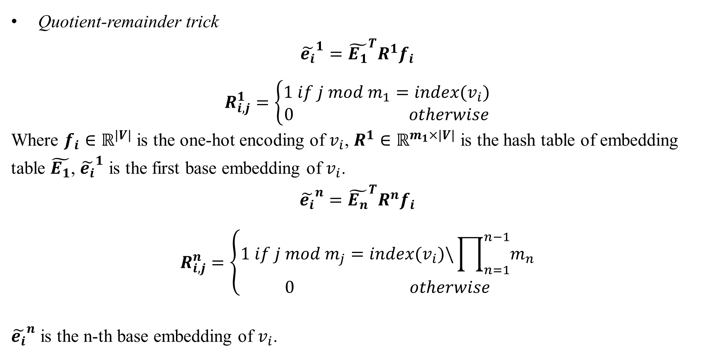
Dynamic Context-aware Compositional Embedding
Quotient-remainder trick
$${\tilde{e_{i}}}^{1}={\tilde{E_{1}}}^{T}R^{1}f_{i}$$
$$R_{i,j}^{1}=\left\{\begin{aligned}1 if j mod m_{1}=index(v_{i}) \\ 0 otherwise\end{aligned}\right.$$
Where $f_{i}∈ℝ^{|V|}$ is the one-hot encoding of $v_{i}$, $R^{1}∈ℝ^{m_{1}×|V|}$ is the hash table of embedding table $\tilde{E_{1}}$, ${\tilde{e_{i}}}^{1}$ is the first base embedding of $v_{i}$.
$${\tilde{e_{i}}}^{n}={\tilde{E_{n}}}^{T}R^{n}f_{i}$$
$$R_{i,j}^{n}=\left\{\begin{aligned}1 if j mod m_{j}=index(v_{i})\backslash \prod_{n=1}^{n−1}{m_{n}} \\ 0 otherwise\end{aligned}\right.$$
${\tilde{e_{i}}}^{n}$ is the n-th base embedding of $v_{i}$.

Slide 7
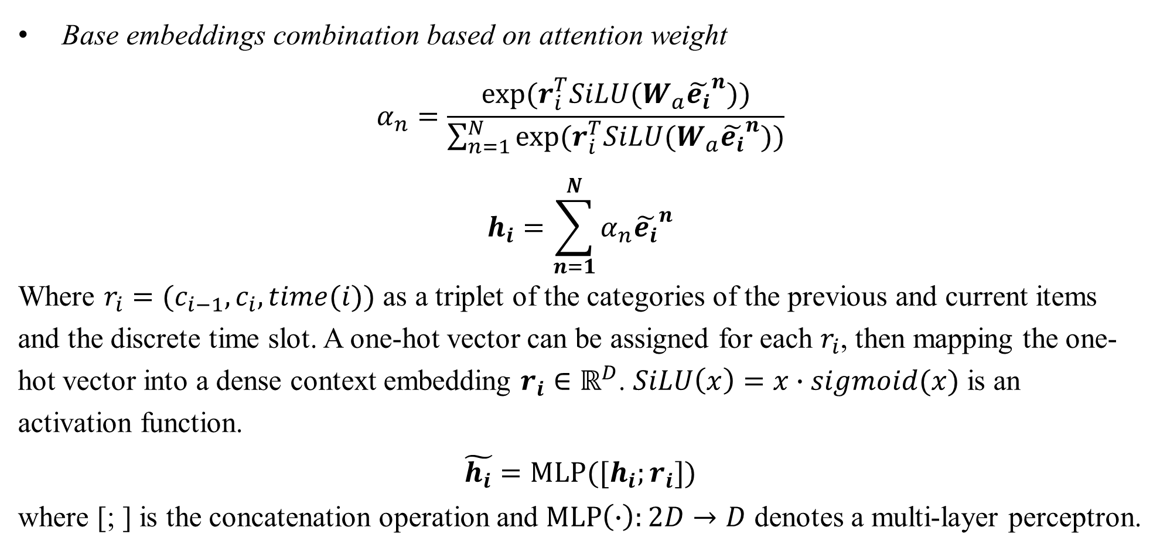
Dynamic Context-aware Compositional Embedding
Base embeddings combination based on attention weight
$$α_{n}=\frac{exp⁡(r_{i}^{T}SiLU(W_{a}{\tilde{e_{i}}}^{n}))}{\sum_{n=1}^{N}{exp⁡(r_{i}^{T}SiLU(W_{a}{\tilde{e_{i}}}^{n}))}}$$
$$h_{i}=\sum_{n=1}^{N}{α_{n}{\tilde{e_{i}}}^{n}}$$
Where $r_{i}=(c_{i−1},c_{i},time(i))$ as a triplet of the categories of the previous and current items and the discrete time slot. A one-hot vector can be assigned for each $r_{i}$, then mapping the one-hot vector into a dense context embedding $r_{i}$ $∈ℝ^{D}$. $SiLU\left(x\right)=x∙sigmoid(x)$ is an activation function.
$$\tilde{h_{i}}=MLP([h_{i};r_{i}])$$
where [; ] is the concatenation operation and $MLP\left(∙\right):2D→D$ denotes a multi-layer perceptron.

Slide 8
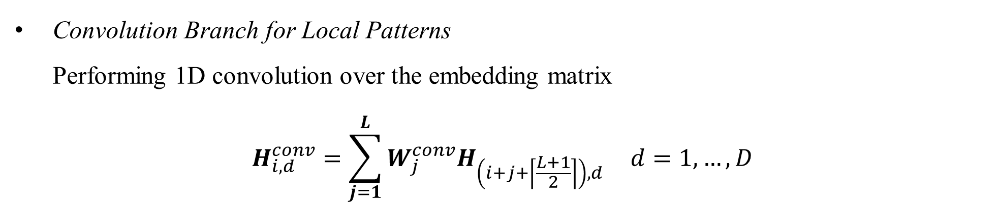
Twin-Attention for User’s Long- and Short-term Preferences
Convolution Branch for Local Patterns Performing 1D convolution over the embedding matrix
$$H_{i,d}^{conv}=\sum_{j=1}^{L}{W_{j}^{conv}H_{\left(i+j+\left\lceil \frac{L+1}{2}\right\rceil \right),d}} d=1,…,D$$
Where $W_{j}^{conv}∈ℝ^{L}$ is the kernel, $H^{conv}∈ℝ^{T×D}$ is the output matrix.

Slide 9
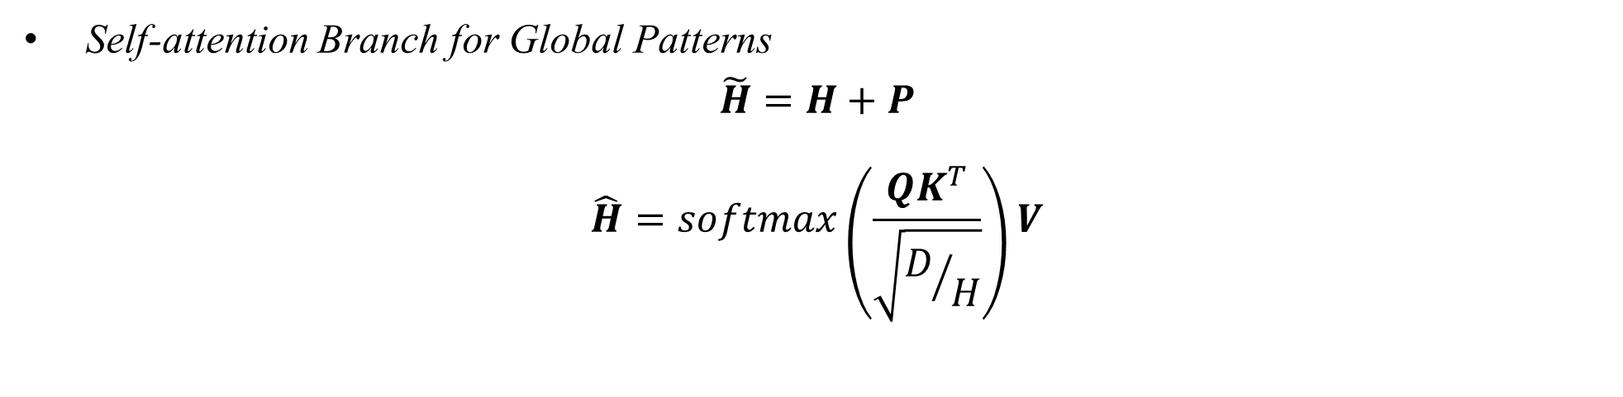
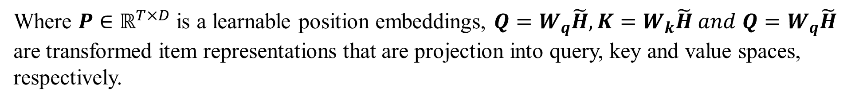
Twin-Attention for User’s Long- and Short-term Preferences
Self-attention Branch for Global Patterns $\tilde{H}=H+P$
$$\hat{H}=softmax\left(\frac{QK^{T}}{\sqrt{D/H}}\right)V$$
Where $P∈ℝ^{T×D}$ is a learnable position embeddings, ${Q=W}_{q}\tilde{H},{K=W}_{k}\tilde{H} and$ ${Q=W}_{q}\tilde{H}$ are transformed item representations that are projection into query, key and value spaces, respectively.
Enhancing Expressiveness with Parallelism
$$H^{twin}=[H_{1}^{conv};…,H_{H}^{conv};H_{1}^{attn};…;H_{H}^{attn}]$$
Each convolution and self-attention modules have $H$ heads in parallel. $H^{twin}∈ℝ^{T×2HD}$ is the final output.

Slide 10
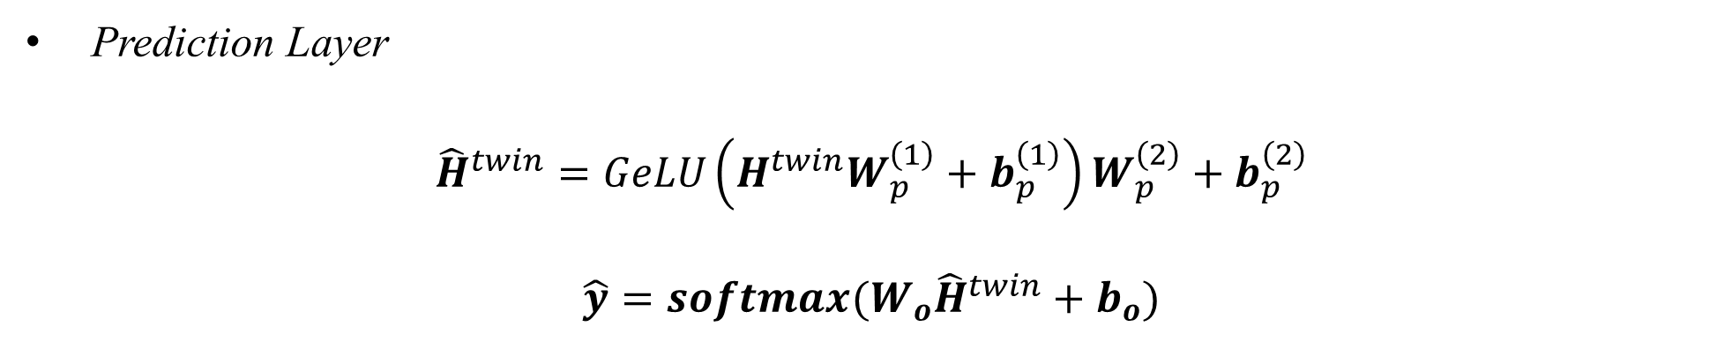

Prediction Layer & Learning Objective
Prediction Layer
$${\hat{H}}^{twin}=GeLU\left(H^{twin}W_{p}^{\left(1\right)}+b_{p}^{\left(1\right)}\right)W_{p}^{\left(2\right)}+b_{p}^{\left(2\right)}$$
$$\hat{y}=softmax(W_{o}{\hat{H}}^{twin}+b_{o})$$
$GeLU(∙)$ denotes the Gaussian error linear unit. $\hat{y}$ is the items probability score distribution.
Learning Objective
$$ℒ=−\frac{1}{S}\sum_{s=1}^{S}{y_{s}^{T}\log\left({\hat{y}}_{s}\right)+λ{\left\|Ψ\right\|}_{2}^{2}}$$

Slide 11
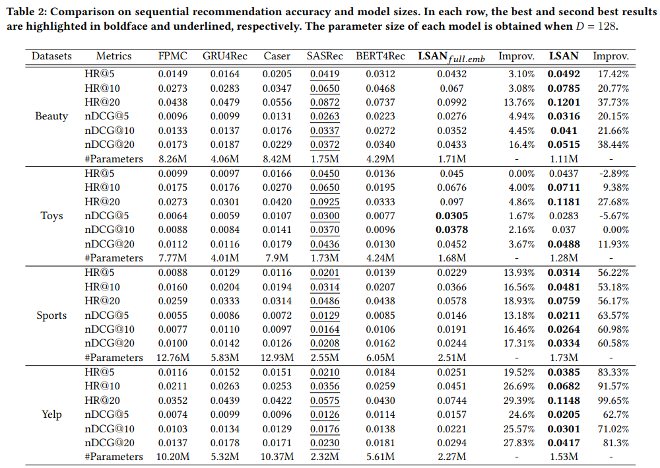
Experiments

Slide 12
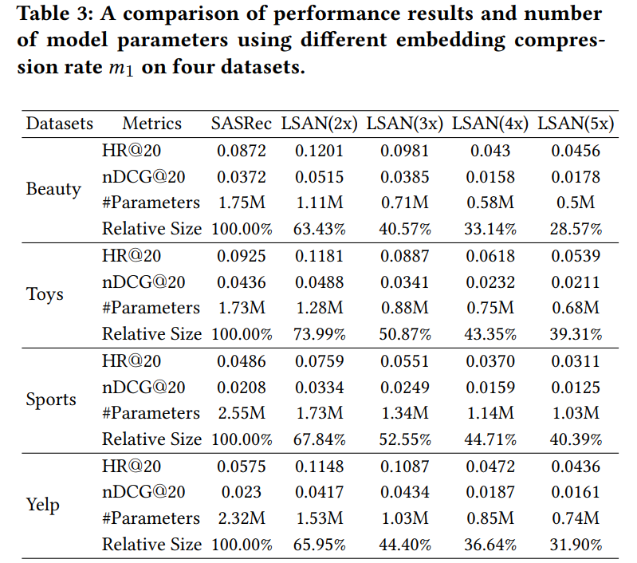
Experiments

Slide 13
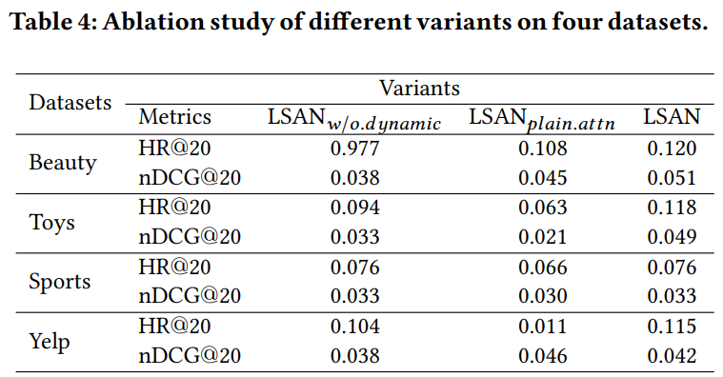
Experiments

